Slide 1
Exploring Ways to Automate Image Description Production for STEM
Ender Tekin
Sue-Ann Ma
Katsuhito Yamaguchi

Slide 2
Accessible Educational Materials (AEM)
According to the US Census Bureau, there are over half a million children with vision difficulties in the US.
Children who cannot effectively read print because of a visual, physical, perceptual, developmental, cognitive or learning disability, are considered to have a print disability.
Disability Resources Offices at schools and school districts, as well as projects such as Benetech (and the associated DIAGRAM Center) work really hard to provide accessible versions of educational materials to students with print disabilities.
Costly
Time-consuming

Slide 3
Image Description
There is a growing emphasis on visual learning, and more graphical content in educational materials.
It is imperative that books can be made fully accessible (including graphical content) in a timely manner to students with print disabilities to ensure that everyone has equal opportunities in education.
The DIAGRAM Center has been working on creating image descriptions, but the process is
Laborious
Time-consuming
Specialized
We need to develop more efficient and scalable ways to create accessible versions of graphical content!

Slide 4
Image Categorization Expert System (ICES)
Categorize images from textbooks
Prioritize description
Guide volunteers through the description based on category-based templates
Redirect to further automation pipelines
Time permitting: Further automated information extraction
Table formatting
Axes labels
Title of image

Slide 5
Category Tree
Image
Numerical
Equations
Chemical Formulas
Diagrams / Charts
Venn Diagram
Pie Chart
Scatter Plot
...etc
Word Art / Titles
Maps
Photos
Paintings / Drawings
Tables

Slide 6
Image Description – current process
Scanned image
This is a barchart with 10 columns showing …
Description
save
Trained describer

Slide 7
Image Description – proposed process 1
Automatic
Categorization
Guided description
Scanned image
This is a barchart ▼
Its title is
Its x-axis label is
Its y-axis label is
The data is provided in the table below…
save
describer

Slide 8
Image Description – proposed process 2
Automatic
Categorization
Automatic
Transcription
<math xmlns="http://www.w3.org/1998/Math/MathML"><mn>14</mn><msqrt><mi>x</mi></msqrt><mo>+</mo><mn>15</mn><mo>=</mo><mn>71</mn></math>
Scanned image

Slide 9
Image categories are vague
Tested on a small corpus of 150 images from math textbooks
3 people categorized the corpus of images
Only 63% agreement on the categories
Categories decided by vote (2/3 wins)
Accuracies ranged from 95% - 73%
Some images are difficult to neatly categorize
Context matters!

Slide 10
Algorithmic Classification – v1.0
Machine learning algorithm trained on a corpus of ~4000 images and tested on a validation set of ~1000 images
Categories are:
Artwork
Chart
Equation
Map
Photograph
Table

Slide 11
Algorithmic Classification – v1.0
Average accuracy around 87%
Accuracy for equations 99%
Working on v2.0
Training takes a long time
Will also add secondary level of classification for charts
Venn diagrams
Bar charts
Pie charts
…

Slide 12
Algorithmic classification – v1.0
On the 150 math image corpus
Accuracy is 74%
Accuracy of equations classified as equations is 95%
Likelihood of other categories classified as equations is 22%
Issues:
Images are small, low resolution
Even people do not agree on images vs. charts very well

Slide 13
Algorithmic classification – v1.0 equations classified as other
Classified as table

Slide 14
Algorithmic classification – v1.0 equations classified as other
Classified as chart

Slide 15
Algorithmic classification – v1.0 equations classified as other
Classified as artwork

Slide 16
Algorithmic classification – v1.0 charts classified as equations

Slide 17
Algorithmic classification – v1.0 charts classified as equations

Slide 18
Algorithmic classification – v1.0 charts classified as equations

Slide 19
Algorithmic classification – v1.0 charts classified as equations

Slide 20
Take-away message
Working on automatic image classification to aid in description
Promising results
Next version being developed
Categories can be vague and complicated
People are not very good at agreeing on categories for an image
Need to evaluate the effect of accuracy on human describers
How much accuracy is good enough to make humans more efficient
Need to evaluate the effect of accuracy on automated algorithms
How much accuracy is sufficient to make good use of ‘next stage’ algorithms to fully automate the transcription process for things like equations

Slide 21
Thanks to
Josh Miele, PhD
Raghuram Janakiraman
Wangtao Lian
Courtney Maxcy
The contents of this presentation were developed under a grant from the National Institute on Disability, Independent Living, and Rehabilitation Research (NIDILRR Grant # 90IF0114). NIDILRR is a Center within the Administration for Community Living (ACL), Department of Health and Human Services (HHS). The contents of this presentation do not necessarily represent the policy of NIDILRR, ACL, HHS and you should not assume endorsement by the Federal Government.
Slides will be available at http://aviatr.waisman.wisc.edu/publications-presentations/

Slide 22


Making Math Books Accessible
The DIAGRAM Center is a Benetech initiative supported by the U.S. Department of Education, Office of Special Education Programs (Cooperative Agreement #H327B100001). Opinions expressed herein are those of the authors and do not necessarily represent the position of the U.S. Department of Education.

Slide 23
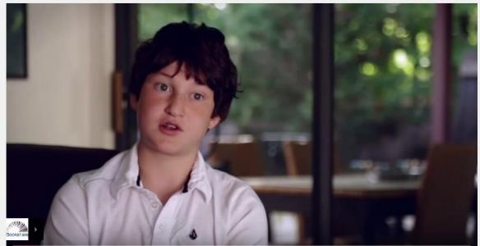
Bookshare, A Benetech Initiative
View video at: https://youtu.be/pqMyXvjAapg
Bookshare: Making reading accessible.
Bookshare is the world’s largest library of accessible ebooks and lets people with visual, physical, and learning disabilities like dyslexia read in ways that work for them.
Notes:
607,000+ titles: Textbooks + books for assigned and pleasure reading + periodicals
550,000 members in 82 countries
24x7 access to books across 34 languages

Slide 24
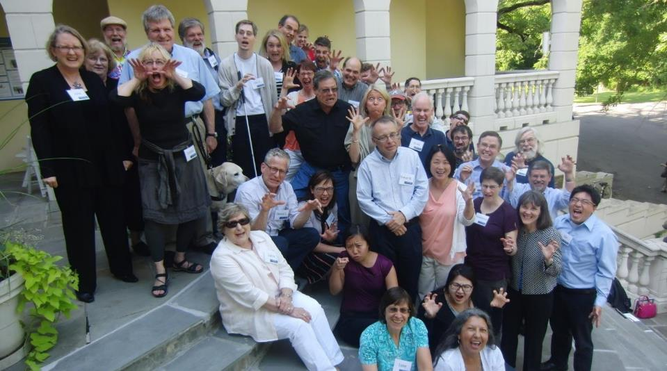
DIAGRAM Center Community
“Most wonderful collaboration I have ever been a part of.”
– DIAGRAM Community Member

Slide 25
Why focus on math?

Slide 26
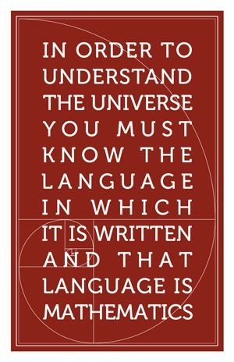
The Problem
Mastery of Mathematics is critical for a successful STEM education
Most digital textbooks passed to Bookshare presents math equations as images
This causes accessibility issues for learners with various print disabilities (e.g., blind, low vision, dyslexic/dyscalculia)
A single math textbook can contain up to tens of thousands of mathematical equations
Transcribing every math equation is extremely time-consuming!
We have pretty accurate math OCR solutions in the market – how do we automate this process?

Slide 27


Benetech’s Math Detective Project

Slide 28
Creating an end-to-end remediation workflow
Unzip ebook to isolate all images
Label math expressions in ebook (via machine learning)
Pre-process images of math equations (optimize for OCR)
Send pre-processed images to math OCR for transcription (i.e., MathML via INFTYReader)
Inject transcribed math back into original ebook

Slide 29
Labelling Math Expressions

Slide 30
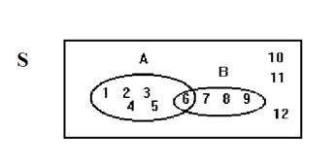
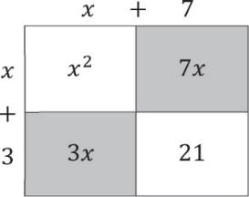
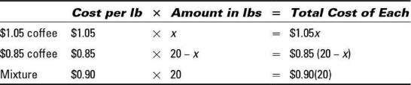
Incorrectly labeled as “ Math Expressions”
Should’ve been labelled “Other Content”

Slide 31




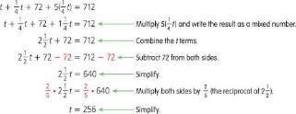
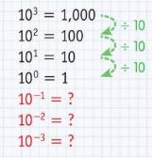
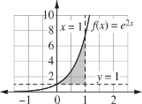
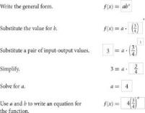
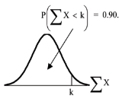
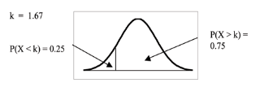


Incorrectly labelled as “Other Content”
Should’ve been labelled “Math Expressions”
Debatable labelling (sometimes difficult for humans to classify)

Slide 32
OCR Results

Slide 33






Example: Single-line expression
Step 1:
convert format (to png)
Step 2:
increase DPI (to 600 dpi)
Step 3:
convert to high contrast b&w
Step 4:
add white border
Step 5:
increase canvas size (200%)
7 of 21 errors
7 of 21 errors
7 of 21 errors
3 of 21 errors
1 of 21 errors

Slide 34
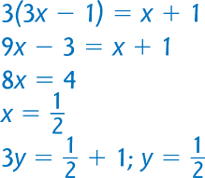
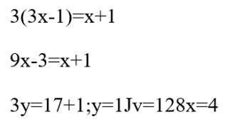




Example: Multi-line expression in blue
Step 1:
convert format (to png)
Step 2:
increase DPI (to 600 dpi)
Step 3:
convert to high contrast b&w
Step 4:
add white border
Step 5:
increase canvas size (200%)
9 of 46 errors
5 of 46 errors
7 of 46 errors
4 of 46 errors
0 of 46 errors

Slide 35
The Pursuit for Automation: Summary of Outcomes
Labelling: currently ~70%, with targets to increase to ~90% accuracy
OCR: image optimization improved OCR accuracy from ~53% to ~91% (sample set of 82)
Target automation by end of pilot: 81% or higher
 | 50% OCR accuracy | 70% OCR accuracy | 90% OCR accuracy | 95% OCR accuracy
50% labelling accuracy | 25% | 35% | 45% | 48%
70% labelling accuracy | 35% | 49% | 63% | 67%
90% labelling accuracy | 45% | 63% | 81% | 86%
95% labelling accuracy | 48% | 67% | 86% | 90%

Slide 36
InftyReader
by: Katsuhito Yamaguchi, NPO: Science Accessibility Net (sAccessNet) http://www.sciaccess.net/en/

Slide 37
What is InftyReader?
Developed by Dr. Masakazu Suzuki.
InftyReader is an Optical Character Recognition (OCR) application that recognizes image-based STEM content automatically, and can then convert it into LaTeX, MathML, and/or Word XML.

Slide 38
InftyReader: Target Documents
Printed books
Images of equations
PDF files that include image-based math expressions (not text-based expressions).

Slide 39
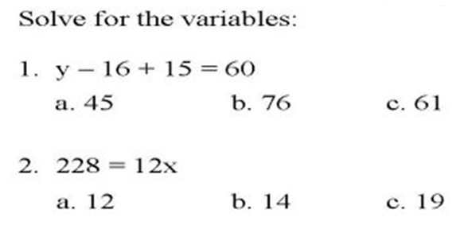
Example: Simple Layout Document
Automatic conversion of simple layout documents is easy with InftyReader. For example:

Slide 40
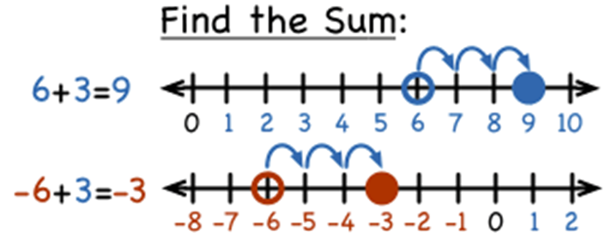
Example: Complex Layout Document.
Automatic conversion of complex layout documents is not easy and normally requires a combination of automatic and manual actions. For example:

Slide 41
InftyReader: Minimum Requirements

Slide 42
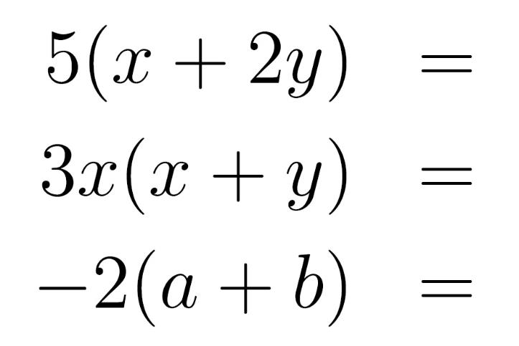
No Pixilation, 600DPI, B&W (Binary) Only, Example 1

Slide 43
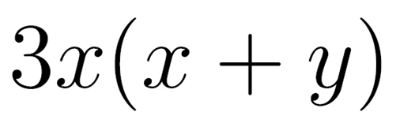
No Pixilation, 600DPI, B&W (Binary) Only, Example 2

Slide 44
Examples of Images That do not Meet InftyReader’s Minimum Requirements

Slide 45

Pixelated, Grayscale Characters

Slide 46

Pixelated and/or Grayscale Characters

Slide 47
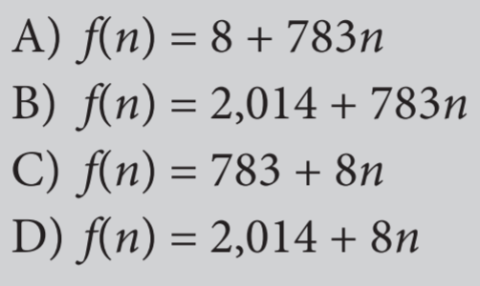
Background Colors

Slide 48
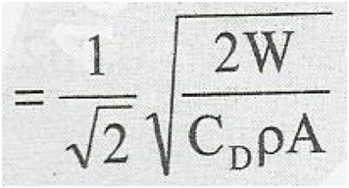
Dirty Background or Off-Horizontal

Slide 49

Characters Running Together

Slide 50


Broken Characters

Slide 51

Background Patterns

Slide 52
InftyReader3: New Features

Slide 53
Cut-and-Paste Conversion
Using "Snapshot" function in Acrobat Reader, one can cut out a math image in 600DPI from PDF STEM contents.
It is converted into an accessible form automatically and can be pasted into a Microsoft-Word/ChattyInfty document.
InftyReader recognizes it in the background, and a user can use this function in a similar manner to the ordinary cut and paste.

Slide 54
E-Born PDF
Originally produced in an electronic way such as LaTeX, Microsoft Word, etc.
Character information is embedded in it.

Slide 55
Recognition of STEM Contents in E-Born PDF
By making Use of character information analyzed by a PDF parser, the current version of InftyReader can get a better recognition result.

Slide 56
ChattyInfty3: Accessible STEM-Document Editor

Slide 57
What is ChattyInfty 3?
ChattyInfty 3 is a talking math editor. It can be used to edit the files processed (OCR’d) by InftyReader.
Once editing is complete, ChattyInfty 3 can export files into a wide range of accessible formats.

Slide 58
ChattyInfty 3: File Export Formats (1 of 2)
LaTeX
HTML
MathML
Microsoft Word XML
Spoken Text

Slide 59
ChattyInfty 3: File Export Formats (2 of 2)
DAISY 2.02 multimedia
DAISY 2.02 audio
DAISY 3 multimedia
DAISY 3 text (with audio for math)
DAISY 3 text-only
EPUB3 media overlays
EPUB3 no audio
EPUB3 iBooks media overlays

Slide 60
Contact Information
NPO: Science Accessibility Net
URL: http://www.sciaccess.net/en/
E-mail: office@mail.sciaccess.net
US Dealer: Ideal Group, Inc.
URL: http://www.inftyreader.org/

Slide 61
Acknowledgement
In this presentation, some resources were provided by Steve Jacobs at the Ideal Group, Inc. I greatly appreciate his kind support.

Slide 62
Questions?
Ender Tekin etekin@wisc.edu
Sue-Ann Ma sueannm@benetech.org
Katsuhito Yamaguchi Katsuhito.Yamaguchi@nifty.com
Slides to be posted at: diagramcenter.org

